Slide 1


Slide 2


Slide 3

DIAGNOSIS SUPPORT OF SKIN LESION CLASSIFICATION USING CNN AND SOFT ATTENTION
Đỗ Hoàng Khôi – 20200332 – CTTT Điện tử 01.
TS. Nguyễn Việt Dũng

Slide 4
Problem Statement
9,500
people are diagnosed with skin cancer each day in the US
3,600,000
People diagnosed with basal cell skin each year.

Slide 5
Problem Statement
AMERICAN CANCER SOCIETY 2022 STATISTICS
100,000
People suffer from skin cancer
7,600
People will NOT survive

Slide 6
Literature Review
DEEP LEARNING | MACHINE LEARNING
Soft Attention | Decision Tree
Dual Attention | XGBoot
Deep CNN | Random Forest
Deep CNN + Metadata | Support Vector Machine
Deep CNN + Cutout | Matrix Transformation
Student and Teacher Model | Isolation Forest
GradCam and Kernel SHAP

Slide 7
Objective
Analyzing the effect of metadata on the skin lesion classification model which is formed by the combination of Soft Attention and Backbone Model
Finding out a method to make the model classify in a balanced way between classes
Constructing an optimized model that can be used on the mobile phone.

Slide 8
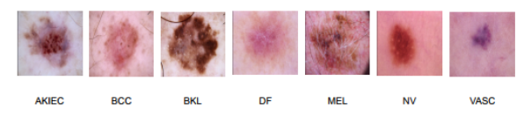
Data – Image Data
Image Size: (450, 600)
Type: RGB
Preprocess:
Scale in range (0,1) or (-1, 1)
Change type: BGR, Grayscale
Resize: (224, 224)

Slide 9
Data - Metadata
Metadata Description
Gender | Age | Localization
Male, Female, and Unknown | 0 – 85 years old | 18 capturing points from all part of body
Missing 0 data point | Missing 57 data points | Missing 0 data point
Approaching Way:
Remove 57 data points from the age category
Take full advantage of gender data, consider the “Unknown” data as “prefer not to say”

Slide 10
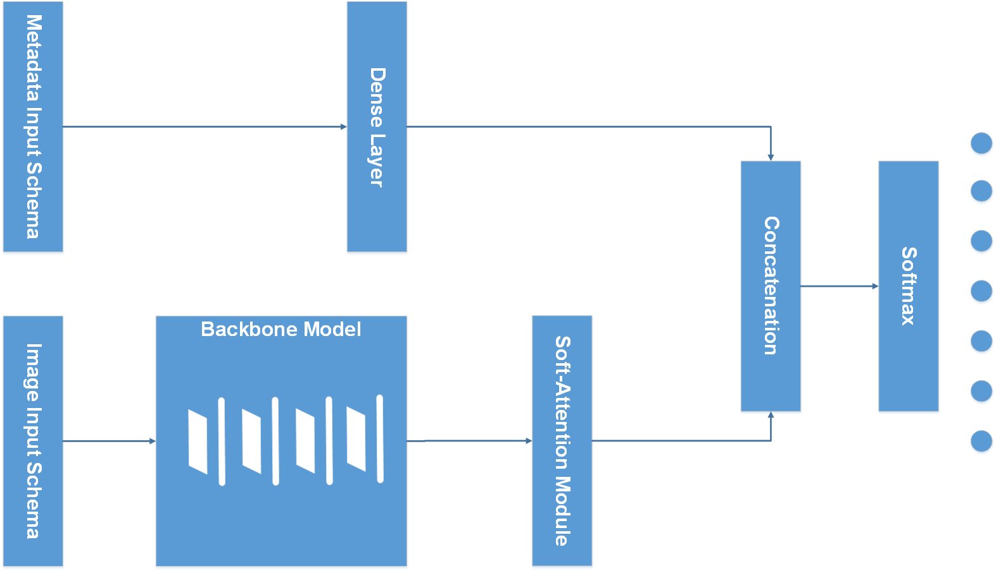
Model Schema

Slide 11
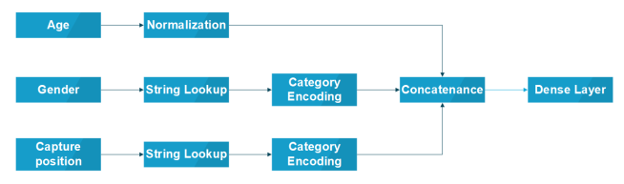
Model Schema – Input Schema

Slide 12

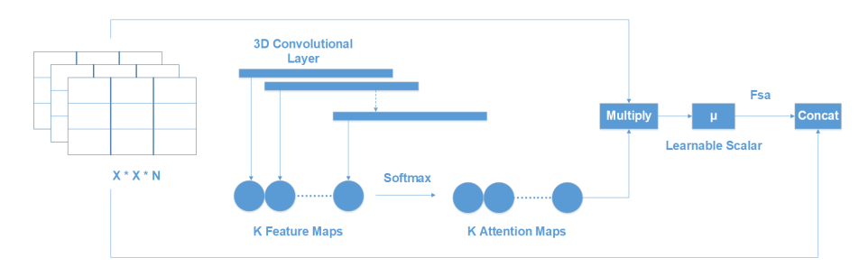
Model Schema – Soft Attention

Slide 13
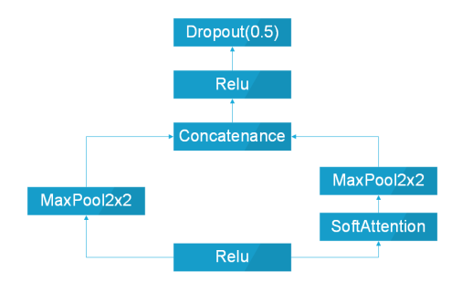
Model Schema – Soft Attention Module Block

Slide 14
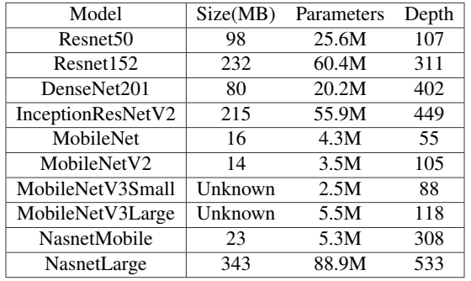
Model Schema – Backbone Model

Slide 15
Model Schema

Slide 16

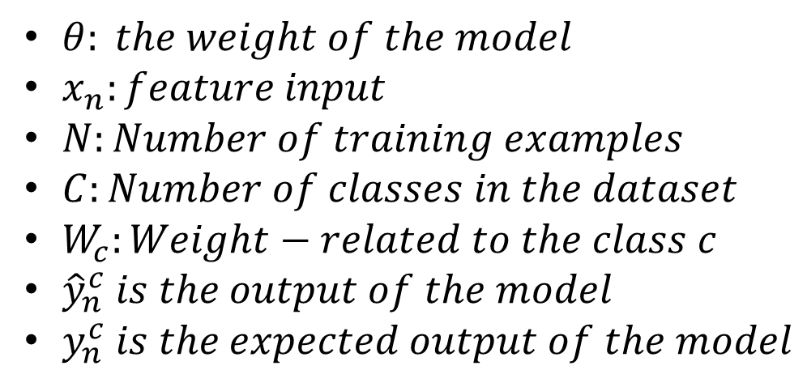
Loss Function
$θ: the weight of the model$
$x_{n}:feature input$
$N:Number of training examples$
$C:Number of classes in the dataset$
$W_{c}:Weight−related to the class c$
${\hat{y}}_{n}^{c} is the output of the model$
$y_{n}^{c} is the expected output of the model$

Slide 17
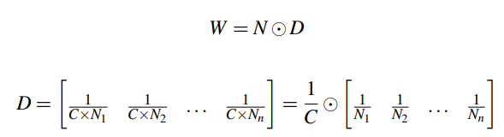
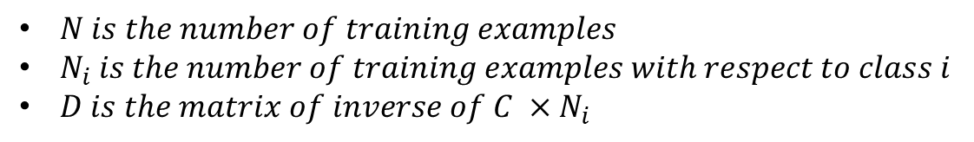
Loss Function
$N is the number of training examples$
$N_{i} is the number of training examples with respect to class i$
$D is the matrix of inverse of C ×N_{i}$

Slide 18
Training
Training | Validation | Testing
80% | 10% | 10%
Tactics during training:
Early-Stopping: Stop when model loss does not decrease
No. waiting epoch: 35
Learning rate Reduction: decrease the learning rate when validation accuracy does not increase
Initial Learning rate: 1e-04
Minimum Learning rate: 1e-08
Model Check-Point: Save the best model – highest accuracy on validation data.

Slide 19
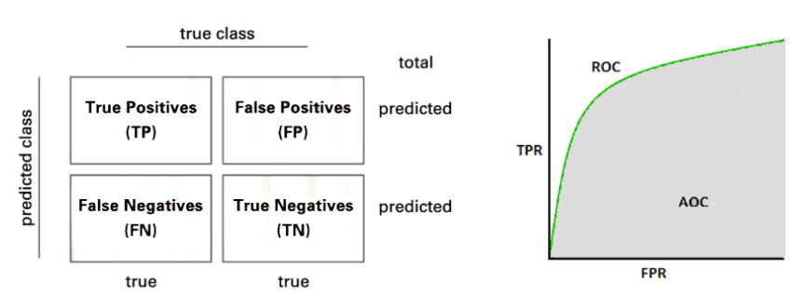
Evaluation Metrics

Slide 20
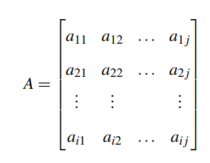
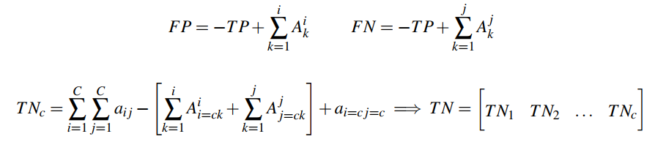
Evaluation Metrics
The True Positive(TP) of all classes, in this case, is the main diagonal of matrix A.

Slide 21
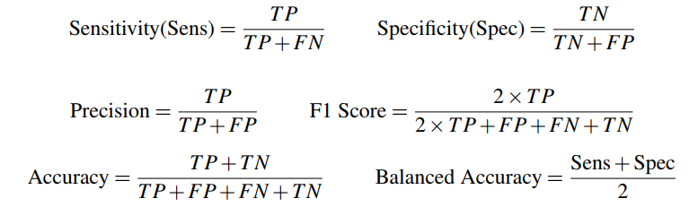
Evaluation Metrics

Slide 22

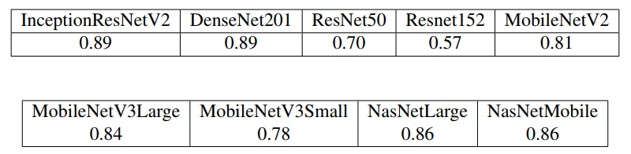
Result and Discussion
Accuracy of the model with Augment Data
Accuracy of the model with Metadata Data

Slide 23
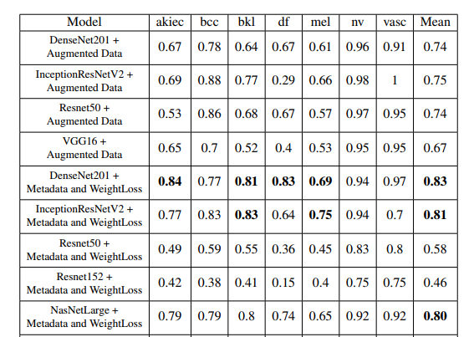
Result and Discussion
F1-score of the models

Slide 24
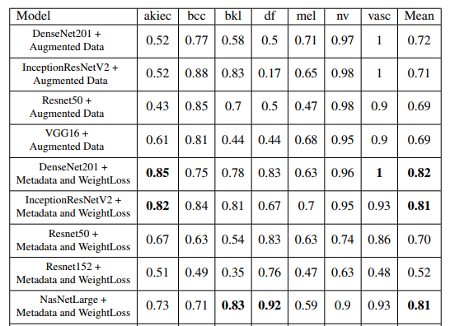
Result and Discussion
Recall-score of the models

Slide 25
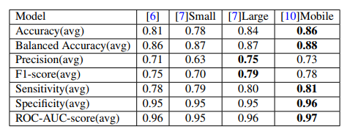
Result and Discussion
Performance of the mobile based models

Slide 26
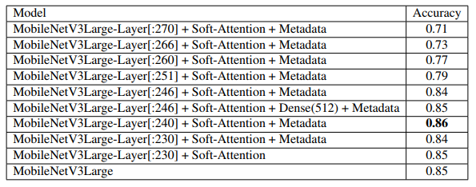
Result and Discussion
Performance of the MobileNetV3Large in different construction

Slide 27
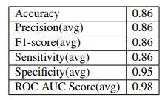
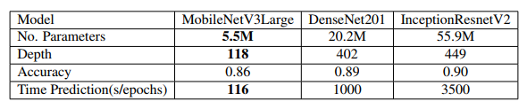
Result and Discussion
Performance of the MobileNetV3Large – the best construction

Slide 28
Conclusion
Metadata improves the model performance but also reduces the balance of the model.
The new weight loss function improve the model performance as well as make the model classify in a balanced way.
Augmented data make the model become more biased.
The combination of mobile-based mobile and Soft Attention has an outstanding performance on HAM100000.

Slide 29
THANK YOU !

